Slide 1
SEGMENTATION AND DENOISING of retinal vessels
PROJECT BY
PRANAVPAL REDDY PINGILI

Slide 2
OVERVIEW
An unsupervised automated technique for detection of retinal vasculature by using morphological hessian based approach and region based Otsu thresholding.
Notes:
Diabetic Retinopathy (DR) harm retinal blood vessels in the eye causing visual deficiency.
The appearance and structure of blood vessels in retinal images play an essential part in the diagnoses of an eye sicknesses.
In this way, a completely automated framework extracting the vessel structures in retinal images could surely diminish the workload of eye clinicians.
THIS IS a less computational unsupervised automated technique with promising results for detection of retinal vasculature by using morphological hessian based approach and region based Otsu thresholding.
---------------------------extra for reference --------------------------------------------------------
((Segmentation and review of retinal vasculature characteristics for example, tortuosity, normal or abnormal branching, shading and diameter as well as the optic disk morphology permits eye care experts and ophthalmologists to perform mass vision screening exams for early discovery of retinal ailments and treatment assessment. This could forestall and decrease vision debilitations, age-related diseases, and numerous cardiovascular ailments, and in addition diminish the expense of the screening [4, 5]. In manual assessment, segmentation and estimation accuracy also fluctuates relying upon nature of the retinal images, graders ability and experience.
Moreover, manual segmentation and estimation procedures can take up to an hour for assessment of just a single eye. In this way, a completely automated framework extracting the vessel structures in retinal images could surely diminish the workload of eye clinicians.))

Slide 3
DATASETS
The DRIVE and the STARE datasets images are used for analysis and experiments of the proposed method.
Notes:
These datasets consists of manual segmented retinal images by experts
The DRIVE and the STARE datasets consist of 400 and 200 retinal images, respectively classified into two sets: the training set and the test set.
he Digital Retinal Images for Vessel Extraction (DRIVE) dataset is a dataset for retinal vessel segmentation. It consists of a total of JPEG 400 color fundus images;
including 70 abnormal pathology cases.
The images were obtained from a diabetic retinopathy screening program in the Netherlands
Each image resolution is 584*565 pixels with eight bits per color channel (3 channels).
The set of 40 images was equally divided into 20 images for the training set and 20 images for the testing set
The STARE (Structured Analysis of the Retina) dataset is a dataset for retinal vessel segmentation. It contains 20 equal-sized (700×605) color fundus images

Slide 4
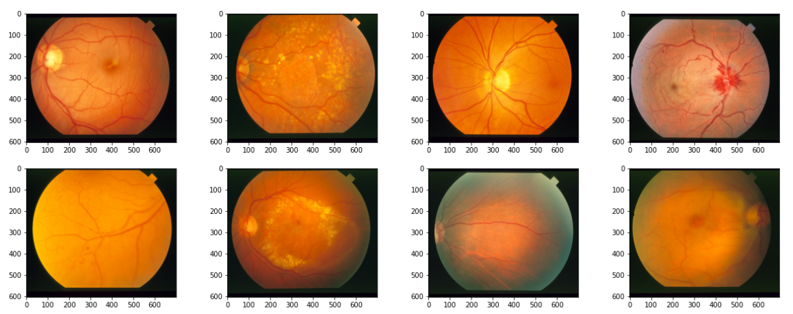
SAMPLE INPUTS

Slide 5
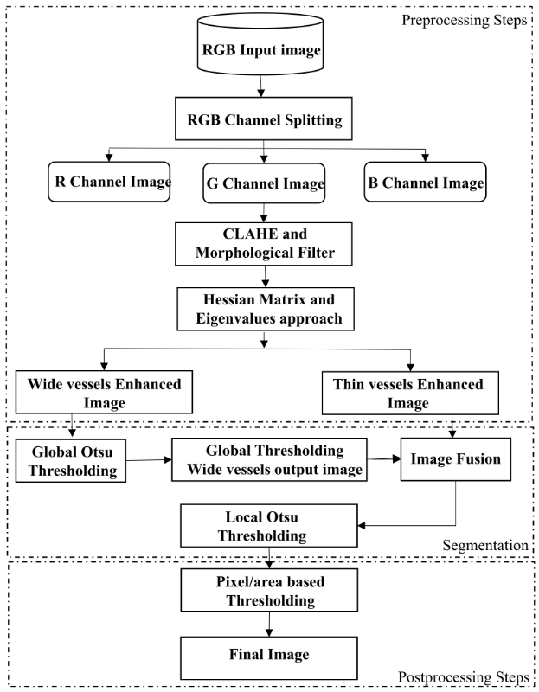
METHODOLOGY
Notes:
block diagram of our proposed segmentation framework.
We extract green channel from input RGB retinal image for further processing.
The green band of input image is further analyzed by using following noteworthy steps :
CLAHE and morphological filters have been used for vessel contrast enhancement and low frequency noise/geometrical objects removal respectively.
Hessian matrix and eigenvalues transformation has been applied in a modified form at two different scales to extract wide and thin vessels enhanced images, separately.
Global and local Otsu thresholding has been utilized in a modified way to classify vessel and non-vessel pixels from wide and thin vessel enhanced images, respectively.
Postprocessing steps have been used for eliminating background noise, undesired segments and erroneously detected vessel pixels. We labelled vessel pixels ‘1’ and non-vessel pixels ‘0’ to obtain a final binary image.

Slide 6
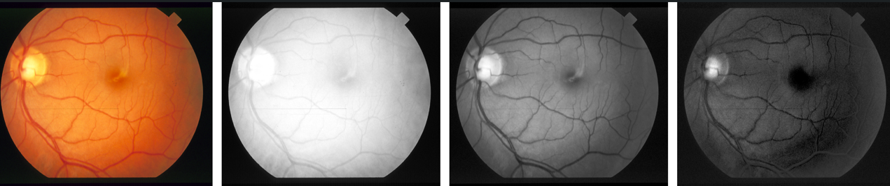
RGB CHANNEL SPLITTING
Notes:
We have used green channel of retinal image for analysis and segmentation of vessel structure.
Fig shows that in green channel, blood vessels seems more differentiated than the background as compared to red or blue channel.
FIG - Retinal RGB image and its channels visual inspection.
(a) RGB input image. (b) Red channel. (c) Green channel. (d) Blue channel.

Slide 7
Contrast Limited Adaptive Histogram Equalization
CLAHE used a user-defined value called clip limit to constrain enhancement by clipping the histogram
In THIS case, clip limit is set from 0 to 0.01
Notes:
Generally, histogram equalization techniques can acquire contrast improvement by stretching the gray level values of a low-contrast image.
We used the CLAHE operator to achieve a local contrast enhanced retinal image.
CLAHE used a user-defined value called clip limit to constrain enhancement by clipping the histogram.
The clipping level specifies noise level to be smoothen and contrast level to be enhanced in histogram.
In our case, clip limit is set from 0 to 0.01

Slide 8

MORPHOLOGICAL FILTERING
utilized morphological top-hat transformation to find difference between the input and the opened image.
Notes:
Vessel structure appears in more prominent contrast than background intensity variations.
However, a more local investigation of vessel intensities can indicate noteworthy changes that can adversely influence the whole vessel extraction process.
To overcome such changes, we have proposed a morphological filter known as modified top-hat transform which has been applied on normalized green channel image.
The thickest vessel width is set as a reference, which normally varies between 1 to 8 pixels covering all diameter ranges of vessels width for both image databases utilized as a part of our proposed scheme.
Vessel diameter scale can be adapted according to image resolution variations.
We have utilized morphological top-hat transformation to find difference between the input and the opened image.
Closed image followed by the opened image to obtain inverse image.
Implementation of top-hat transformation has an issue of noise sensitivity, which cause that pixel values in an opened image are always less than or equal to the input ones;
in such conditions, the subtracted image holds little intensity variations that can be found in the data.
To solve this problem we adapted from modified top-hat transform by introducing two new steps: a closing operator followed by the opening, without using any minimum operator and comparison.
Modified top-hat transform adapted from [15] is given by ABOVE FROMULA
FORMULA shows our modified top-hat transform in which I is the input green channel image while S_{c} and S_{o} stand for the structuring elements for closing (⋅) and opening (∘) operators, respectively. In our case, we select disk type structuring elements for both opening and closing operator having radius eight pixels.

Slide 9
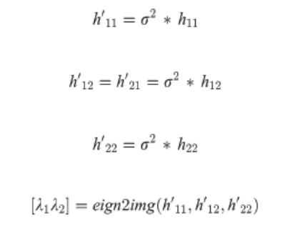
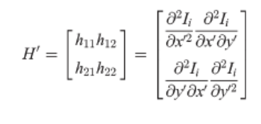
HESSIAN MATRIX AND EIGEN VALUES TRANSFORMATION
Hessian matrix of the directional image I_{i} in the new coordinates Cx′y′ is determined as
Notes:
We have applied hessian matrix and eigenvalues transformation in a new way after morphological filter to obtain enhanced images of wide and thin vessel.
We have computed the second derivative of the image at two different scales for wide and thin vessel enhancement, separately.
This isolation of wide and thin vessels has been achieved by using hessian matrix and eigenvalues based approach.
The vessels having variable width are highlighted and based on the analysis of second order derivative at two different scales.
The eigenvalues of hessian matrix and the difference between them have been used for further contrast enhancement and suppression of non-vasculature structure.
We have applied eigenvalues transformation on hessian matrix to obtain eigenvalues λ₁ and λ₂, while σ is used to define scale of vessel enhancement.
The filter response will be optimum, if the scale σ matches the size of the vessel. In our case, σ ranges from 1 to 2.5 for vessels enhancement.

Slide 10
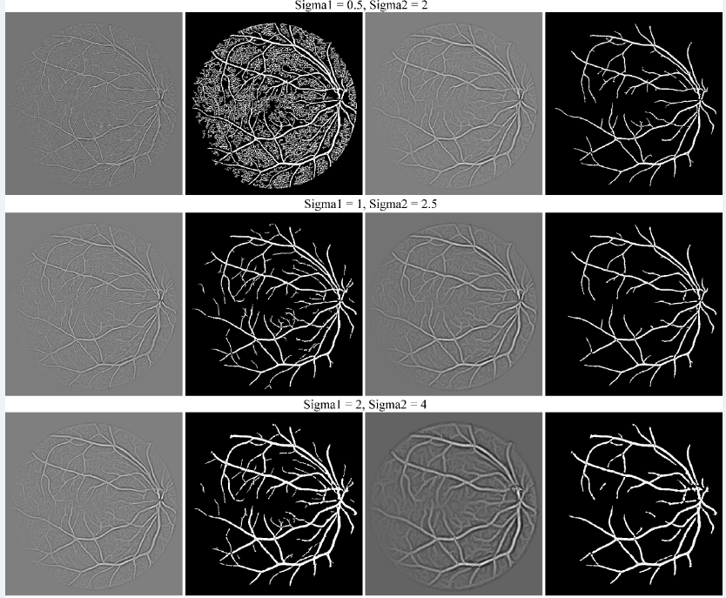
Notes:
Our method reduced the complexity and computation by taking only difference of λ₁ and λ₂ opposed to other existing methods using Frangi’s filter.
Difference images are obtained as I_{image} = λ₂ − λ₁ at two different scales having values 1 and 2.5 for σ.
We have tested the setting of parameter σ on different scalesas shown in Fig 3,
which clearly indicates that setting of smaller scale increased False Positive Rate (FPR) considering background as a vessel pixels.
In case of setting larger scale for σ, which is not able to detect thin vessel pixels decreasing the sensitivity of the proposed method.
Fig 3. Comparison of the setting of parameter σ on different scales.
(a) Thin vessel enhanced image. (b) Thin binary Image. (c) Thick vessel enhanced image. (d) Thick binary image.

Slide 11
Otsu Method for Vessel Segmentation
to suppress the unwanted noise and geometrical objects based on vessel structure
used Otsu’s approach, to divide pixels of an image into two segments S₀ and S₁ (e.g., objects and background) at intensity level t
Notes:
We have applied Otsu’s approach [44] in a modified way to suppress the unwanted noise and geometrical objects based on vessel structure.
Usually Otsu’s approach is used locally or globally on the entire image to find a threshold for classification of vessel and non-vessel pixels.
Applying Otsu threshold on the whole image at once does not give fruitful results that’s why we have applied it separately on wide and thin vessel images.
We have used global threshold on wide vessels enhanced image and fused its resultant image into thin vessel enhanced image.
In this way both thin and thick vessels become more prominent. We obtained a single enhanced image on which further local thresholding has been applied.
In local thresholding, we used vessel based thresholding which depends upon vessel locality to define a new threshold.
We added some offset in the global threshold to suppress the noise more effectively for vessels in the neighborhood of wide vessels.
For other regions away from wide vessels, we set lower threshold than the global by subtracting some offset from it to extract the small or thin vessels from the background having low intensity. Further, postprocessing steps have been applied to obtain final segmented image.
We used Otsu’s approach [44], to divide pixels of an image into two segments S₀ and S₁ (e.g., objects and background) at intensity level t, i.e, S₀ = {0,1,2,…….,t} and S₁ = {t + 1,t + 2,…….,L − 1}.

Slide 12
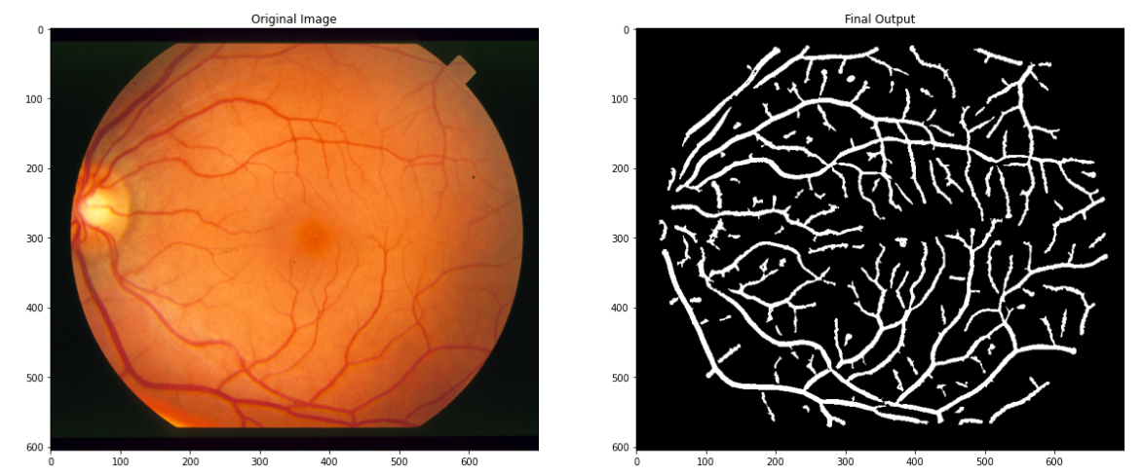

Slide 13
Postprocessing Steps
pixel/area based thresholding
Notes:
We have used pixel/area based thresholding to eliminate unconnected non-vessel pixels.
The segmentation results usually consist of some small isolated regions caused by noise, and these regions are sometimes wrongly detected as vessels.
Based on the connectivity of the retinal vessels, we removed less than or equal to 30 unconnected pixels considered as a non-vessel or a part of the background noise.

Slide 14
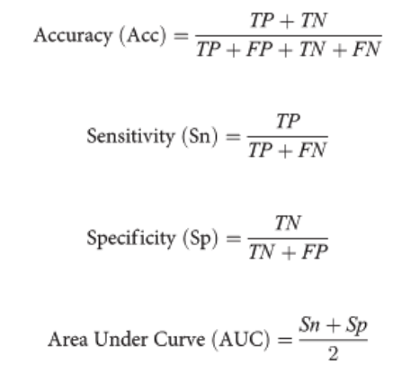
PERFORMANCE EVALUATION
Notes:
Accuracy (Acc), Sensitivity (Sn), Specificity (Sp), and the area under a Receiver Operating Characteristic (ROC) curve, also known as Area Under the Curve (AUC) are four commonly used parameters to compare the performance of the competing techniques.
Accuracy shows the overall segmentation performance.
Sensitivity indicates effectiveness in detection of pixels with positive values: specificity measure the detection of pixels with negative values.
For performance evaluation, the proposed framework has been applied on 20 test images of the DRIVE and the STARE datasets

Slide 15
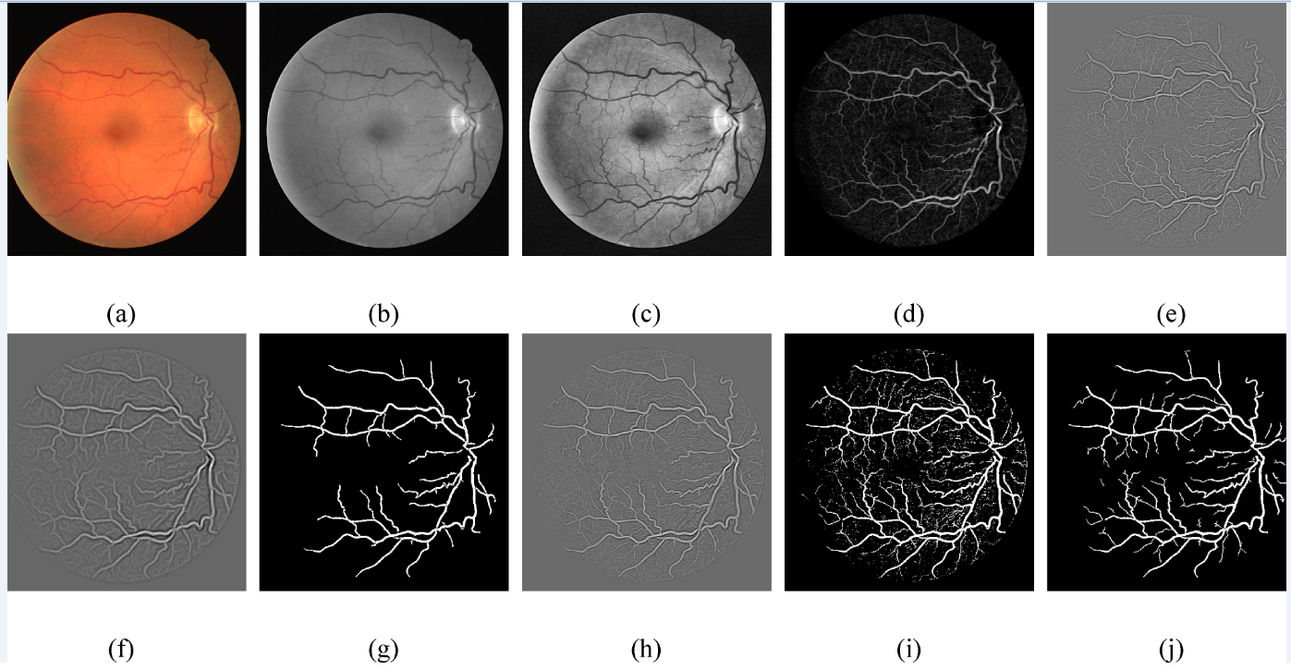
RESULTS
Notes:
Visual inspection of retinal blood vessel segmentation with major processing stages of our proposed framework using the DRIVE and the STARE datasets are depicted IN THE FIG
Fig 4. Proposed method main processing steps for retinal blood vessel segmentation.
RGB image from DRIVE database.
(b) Green Channel
. (c) CLAHE.
(d) Morphological filters.
(e) Thin vessel enhanced image.
(f) Wide vessel enhanced image.
(g) Otsu global thresholding output image.
(h) Fused image of thin enhanced image and Otsu global thresholding output image.
(i) Otsu local thresholding to enhance thin vessels
(j) Postprocessed final binary image.

Slide 16
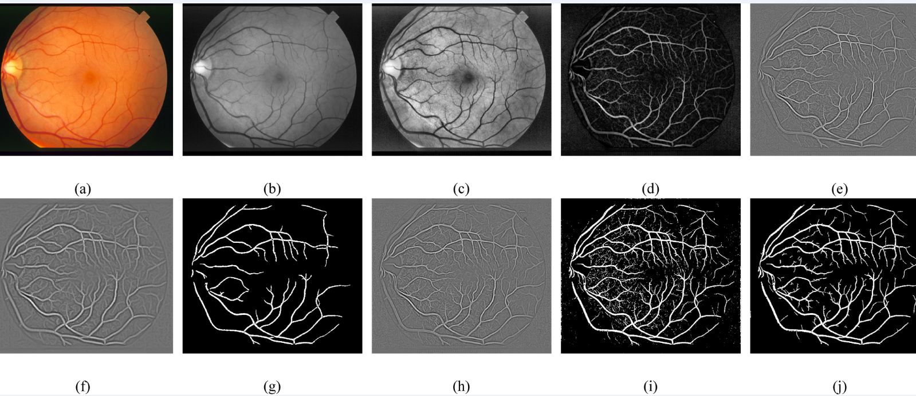
RESULTS
Notes:
Proposed method main processing steps for retinal blood vessel segmentation.
Fig 4. Proposed method main processing steps for retinal blood vessel segmentation.
RGB image from STARE database.
(b) Green Channel
. (c) CLAHE.
(d) Morphological filters.
(e) Thin vessel enhanced image.
(f) Wide vessel enhanced image.
(g) Otsu global thresholding output image.
(h) Fused image of thin enhanced image and Otsu global thresholding output image.
(i) Otsu local thresholding to enhance thin vessels
(j) Postprocessed final binary image.

Slide 17
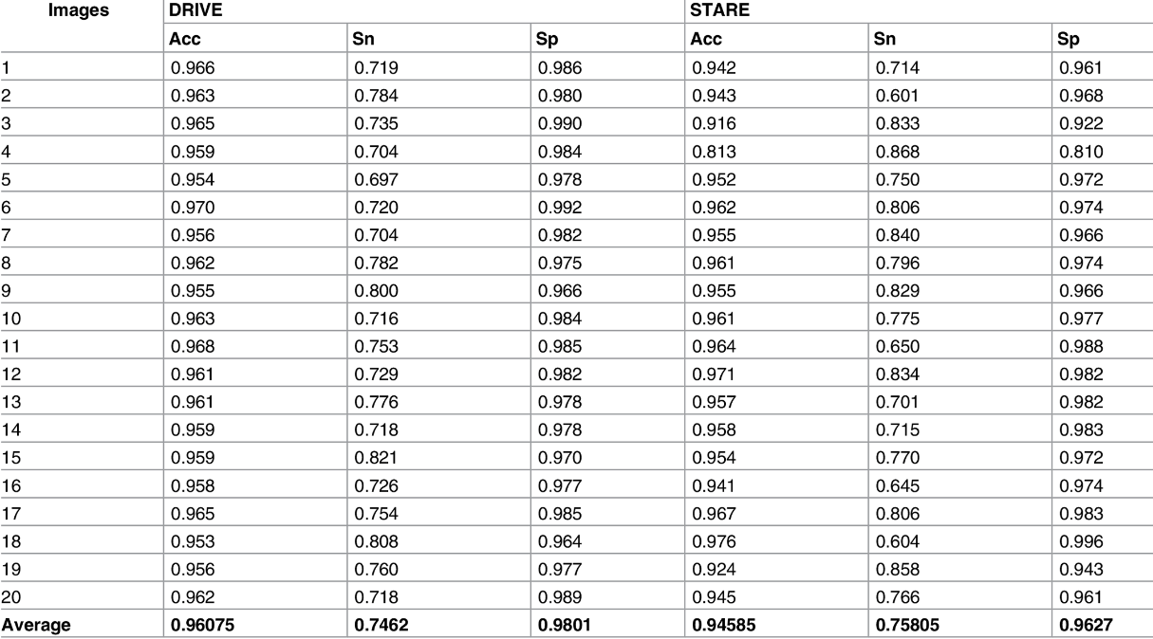
Average accuracy of the proposed method
Notes:
First, we have calculated the average accuracy of 20 test images of the DRIVE dataset and 20 random images of the STARE dataset.
The average accuracy indicates how to extract a binary image that matches the vessel images to a high degree.
The accuracy is estimated by the ratio of the sum of the number of correctly classified foreground and background pixels, divided by the total number of pixels in the image.
According to the results shown in Table , the average accuracy for the DRIVE dataset is 0.96075 and for the STARE dataset is 0.94585.
Table -. Accuracy (Acc), Sensitivity (Sn) and Specificity (Sp) results of proposed method for 20 retinal images of the DRIVE and the STARE datasets.

Slide 18
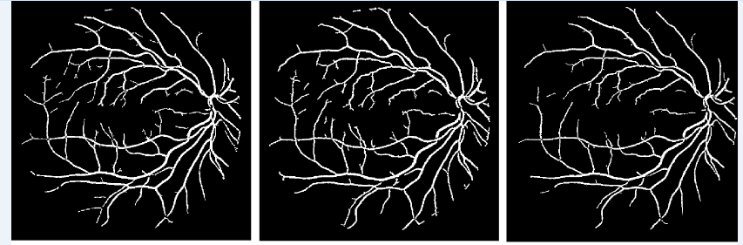
COMPARISION WITH EXISTING METHODS
Notes:
We have compared the proposed Otsu approach with current thresholding algorithms, Technique of Iterative Local Thresholding (TILT) , K-means
Visual results of different thresholding techniques.
(a) Proposed Otsu method. (b) TILT. (c) K-means.

Slide 19
CONCLUSION
Otsu thresholding has been utilized to extract vessel attributes and region properties based thresholding has been used set optimal threshold value to segregate vessel and non-vessel pixels. Proposed method has been applied to different databases like DRIVE and STARE and assessed based on performance measures such as sensitivity, specificity and accuracy. Further, our proposed method has been contrasted with different existing techniques to evaluate its efficiency and reliability
Notes:
The automatic segmentation of blood vessels in retinal image is an important step in diagnosing causes of visual impairment.
In our proposed framework, CLAHE and morphological filter has been used for vessel enhancement and low frequency noise/object removal along with hessian matrix and eigenvalues transformation to classify retinal image into wide and thin vessels enhanced images.
Otsu thresholding has been utilized to extract vessel attributes and region properties based thresholding has been used set optimal threshold value to segregate vessel and non-vessel pixels. Proposed method has been applied to different databases like DRIVE and STARE and assessed based on performance measures such as sensitivity, specificity and accuracy.
Further, our proposed method has been contrasted with different existing techniques to evaluate its efficiency and reliability.
The proposed framework performs efficiently against noise and extract thin vessels. The proposed method is robust and computationally efficient.

Slide 20
THANK YOU

